Slide 1

Artificial intelligence and real-time monitoring to support optimised antimicrobial use
CAMO-UK Research Meeting
21/06/2023
Dr Timothy Miles Rawson, BSc (hons), MBBS, MRCP (UK), PDME, DTM&H, PhD
Health Protection Research Unit for Healthcare Associated Infections and Antimicrobial Resistance
Centre for Antimicrobial Optimisation, Imperial College London

Slide 2

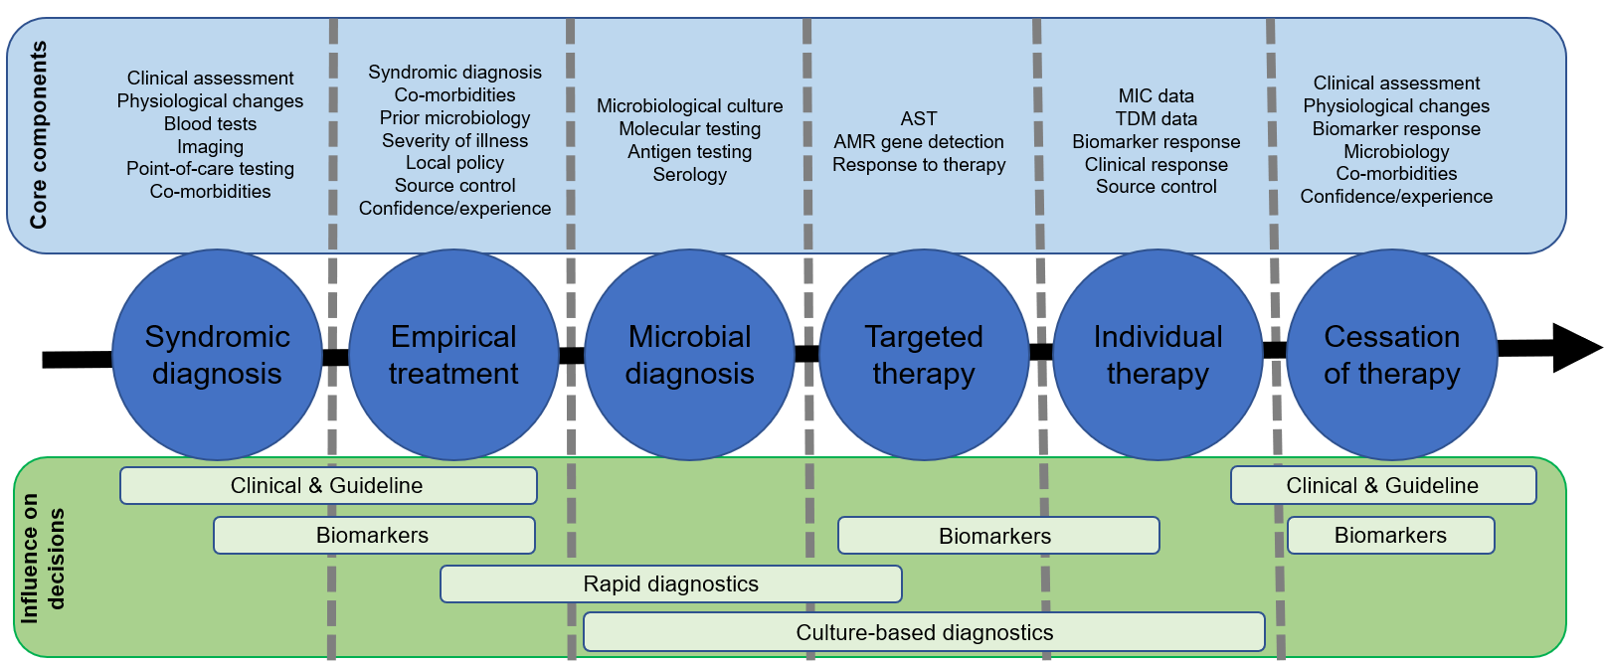
Antimicrobial decision making
Rawson & Moore. Clinical Microbiology & Infection, 2023
Notes:
Complex and adaptive
Multiple decision nodes
Different factors / components that influence decision making

Slide 3
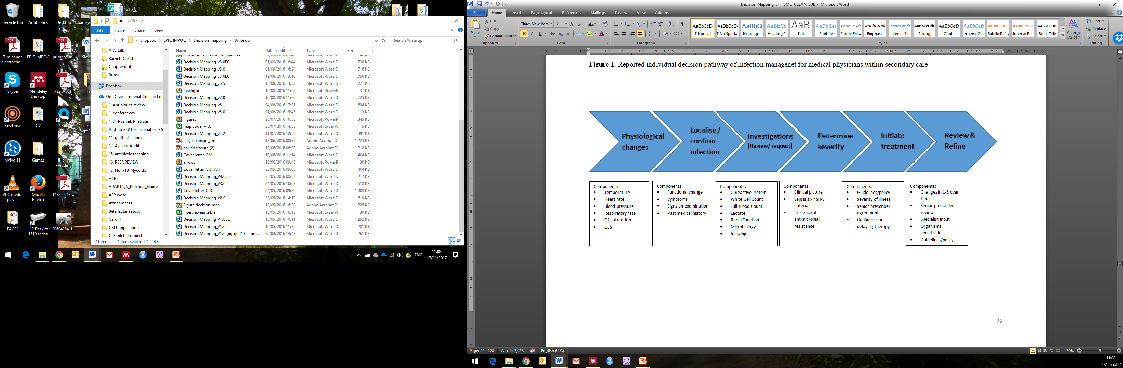
Individual decision making
Current decision support tools
Wearable technologies
Surveillance
Rapid diagnostics
Prediction tools
Point-of-care sensing biomarkers
Machine / supervised machine learning
Rapid diagnostics
Prediction tools
Real time monitoring of therapy
Components:
Temperature
HR / BP
Respiratory rate
O2 saturation
GCS
Components:
Functional change
Symptoms
Signs on examination
Past medical history
Components:
CRP / WCC / FBC
Lactate
Renal Function
Microbiology
Imaging
Components:
Clinical picture
Sepsis six / SIRS
Presence of AMR
Components:
Guidelines/policy
Severity of illness
Senior prescriber agreement
Confidence
Components:
Changes over time
Senior review
Specialist input
Sensitivities
Guidelines/policy
Rawson, et al. BMC Med; 2016
Notes:
Provide better and more individualised data at each step of the physicians decision making pathway to promote better decisions
Shift towards personalised antibiotic therapy which will require major shift in behaviour change approaches
Focus on four areas & potential challenges…
Diagnostics and need for linkage
AI and concerns with using computers
Removing need for behaviour through automoation
Patients are engaged in decision making to promote better behaviours towards abx

Slide 4


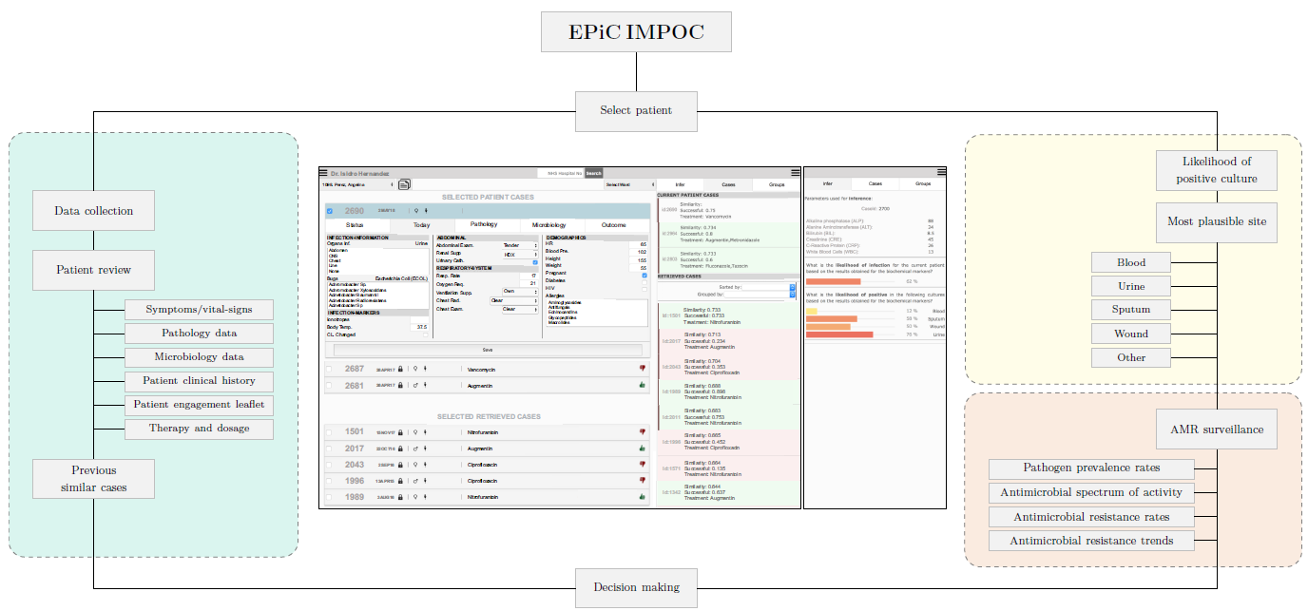

Integrated decision support systems
Data
Intelligent platforms
Augmented decision making
Optimised therapy
Diagnostics
Surveillance
Individual level
Population level
Machine learning
Co-design
End-user engagement
Flexible
Integrated
Risk prediction
Antibiotic selection
Dose optimisation
Forecasting
Communication aides
Individualisation
Precision
Adaptive
Rawson et al. Nature Hum Beh 2019

Slide 5
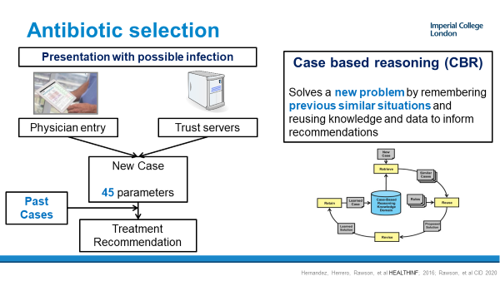
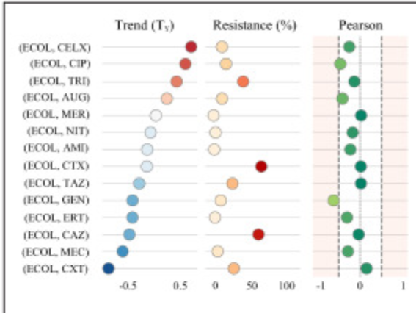
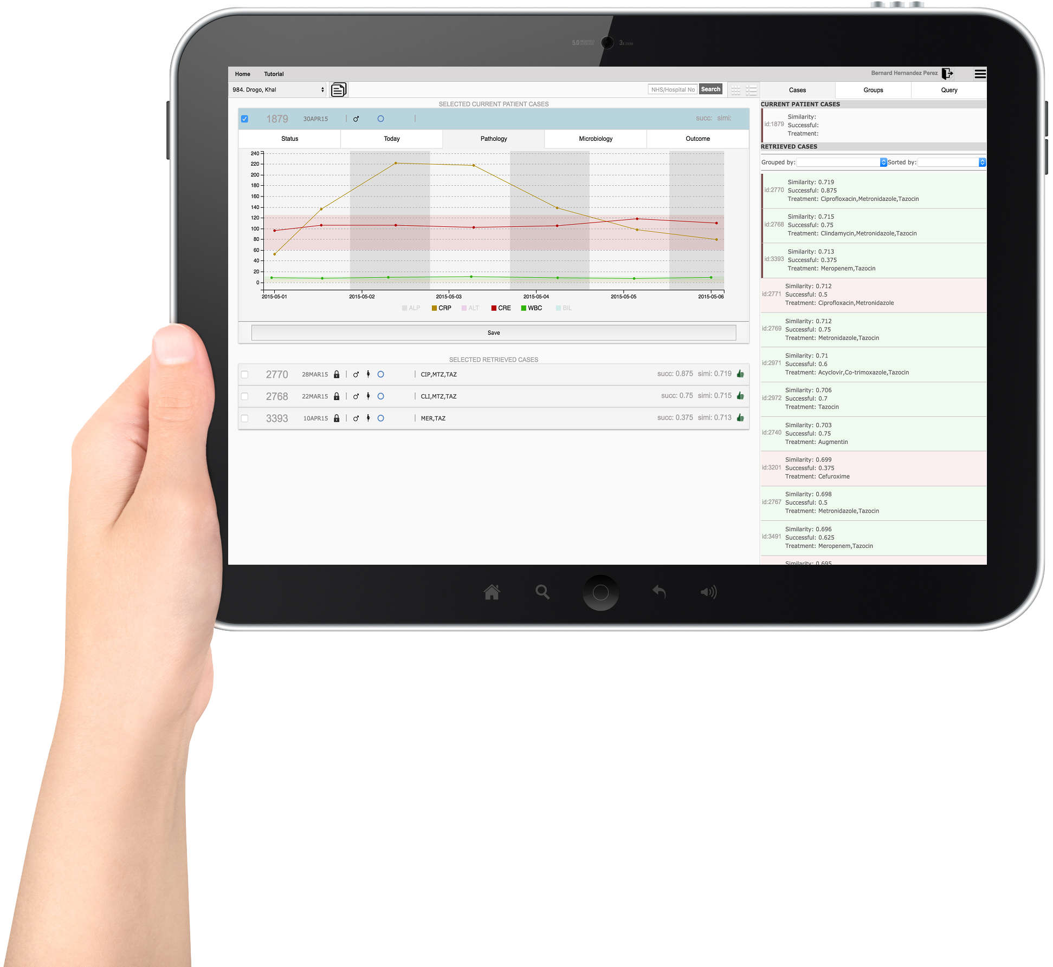
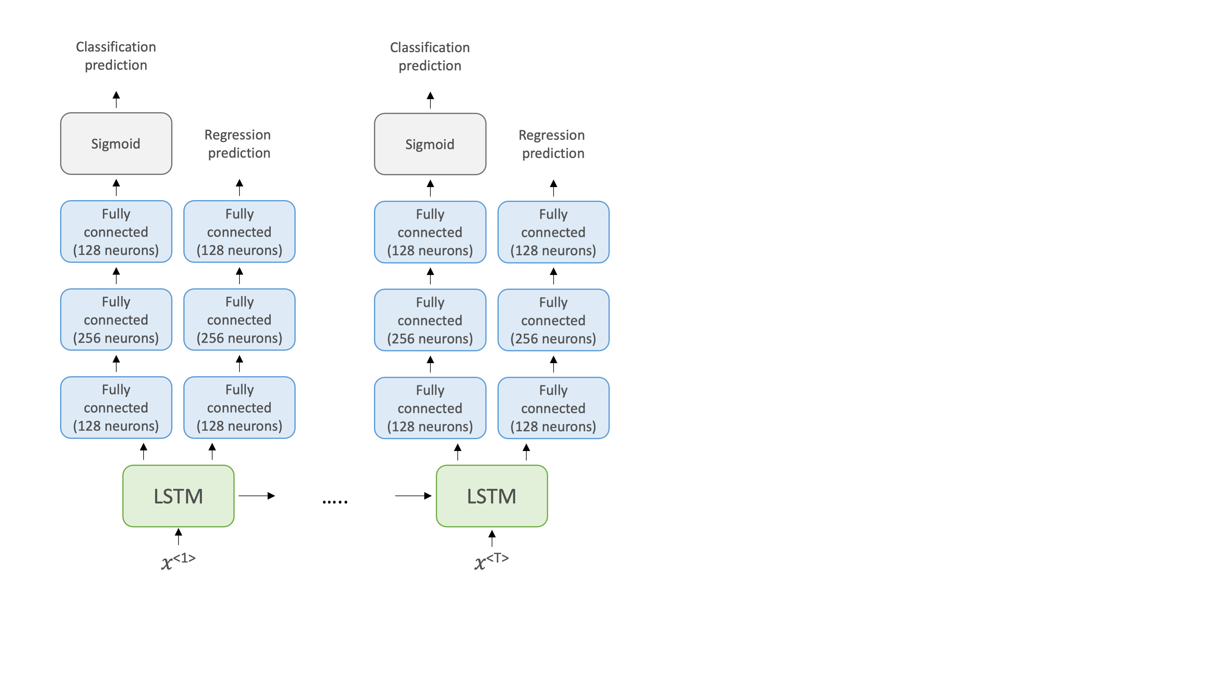
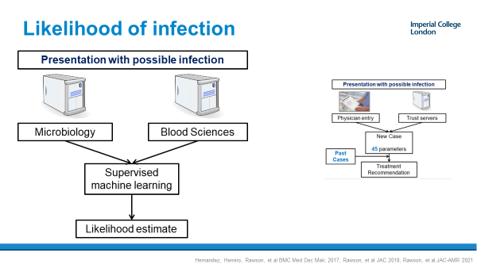

AI-based clinical decision support
Antimicrobial selection
Resistance trend analysis
Probability of infection / site
Determining duration of therapy
Hernandez, et al BMC Med Dec Mak; 2017; Rawson, et al JAC 2018, Rawson, et al JAC-AMR 2021;
Rawson, et al. CID 2020; Hernandez, et al, Antibiotics 2022; Bolton, et al. Front Dig Health 2023
Notes:
Real-world evaluation:
High concordance with clinical practice.
Tools to support:
Narrower antibiotic spectrum.
Prediction of infection likelihood.
Decisions on antimicrobial duration.
Understanding of local resistance trends.
Rapid adaption to support COVID-19 management.
Embedded within information technology infrastructure.
Consideration of equity in decision making.
Ongoing requirement to explore adoption and influence on behaviour.

Slide 6
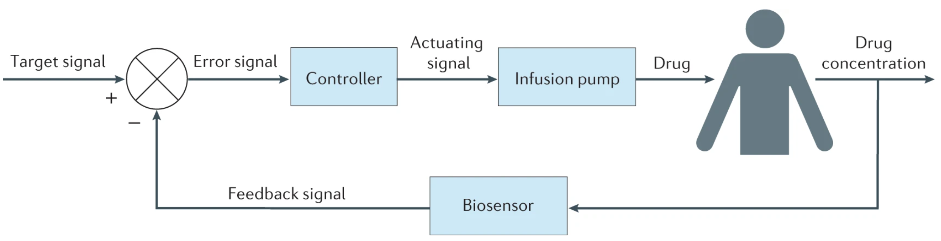
Closed-loop control of
antimicrobial delivery
Proportional-integral-derivative (PID) Iterative learning control
Model-based predictive control
Continuous infusion
Intermittent dosing
PK/PD index
Trough
Target conc.
Continuous monitoring
Point-of-care devices
(HPLC MS)
Notes:
Link real time drug monitoring
Link in-patient monitoring of response
Automatically adjust amount of antibiotic delivered
For the individual patient

Slide 7
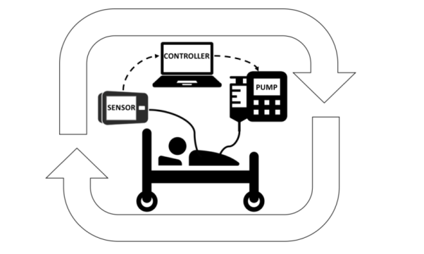

Can technology support antimicrobial optimisation?
Intelligent decision support
Real-time monitoring
In-vivo pharmacodynamics
Automated delivery
Integration with decision making
Individual AUC:EC₅₀
Future steps:
Future proof technology.
Regulatory & governance considerations for moving towards individualised therapy.
Developed with understanding of human behaviour and adoption upon implementation.
Rawson, O’Hare, et al. JAC 2018; Rawson, et al. Nature Rev Micro 2021
Notes:
There are a barriers to delivering truly individualised antimicrobial therapy.
AI and biosensors provide opportunities to address some of the current gaps.
In vivo antimicrobial pharmacodynamic estimation may be a possibility.
Focus on integration of decision support mechanisms.
Future-proof tools to work with emerging technologies.
Understand human behaviour to support future adoption.

Slide 8

